Slide 1
Setting Up Python and Developing a Simple Application
Set Up the Development Environment
Write Python Statements
Create a Python Application
Prevent Errors

Slide 2
Programs Developed in Python
Types:
Web apps
Video games
Audio/video apps
Mobile apps
Networking apps
Scientific/mathematical apps
Security utilities
Education apps
Examples:
BitTorrent
Blender
Django
Dropbox
Odoo
Reddit
YouTube

Slide 3



CPython
Bytecode
Virtual machine
Python code
Program output
0 LOAD_NAME
3 LOAD_CONST
6 CALL_FUNCTION
9 PRINT_EXPR
12 LOAD_CONST
15 RETURN_VALUE+
print("Hello, world!")
Hello, world!

Slide 4
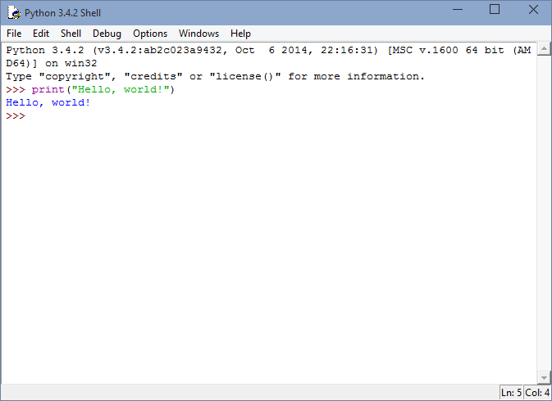
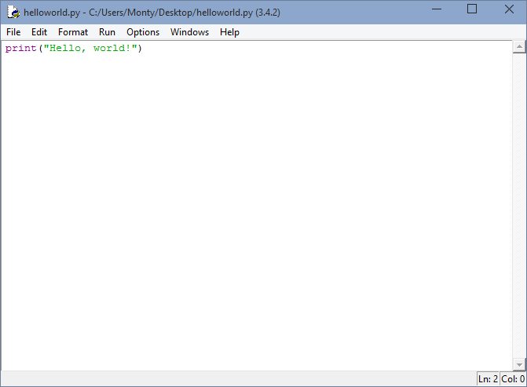
IDLE

Slide 5
Other Python IDEs
PyCharm
Wing IDE
Komodo IDE
Python Tools for Visual Studio
PyDev
Spyder
NINJA-IDE

Slide 6
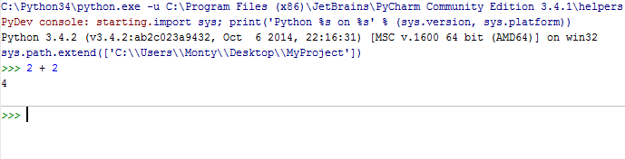
Interactive Mode
Statement entered
Result returned
Next prompt

Slide 7
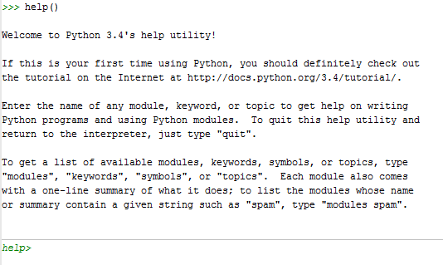
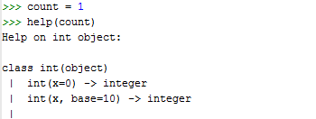
Help

Slide 8
Variable Assignment
my_variable = 1

Slide 9
Reserved Words
False | elif | lambda
None | else | nonlocal
True | except | not
and | finally | or
as | for | pass
assert | from | raise
break | global | return
class | if | try
continue | import | while
def | in | with
del | is | yield

Slide 10
Arithmetic Operators
Operator | Definition | Example
+ | Adds operands together. | 2 + 4 will return 6
- | Subtracts right operand from left operand. | 4 – 2 will return 2
* | Multiplies operands together. | 2 * 4 will return 8
/ | Divides left operand by right operand. | 10 / 2 will return 5
% | Divides left operand by right and returns remainder. | 13 % 4 will return 1
** | Performs exponential calculation with left operand as the base and right operand as the exponent. | 2 ** 4 will return 16

Slide 11
Order of Operations
**
* / %
+ -

Slide 12

The print() Function

Slide 13
String Literals
a = "Hello, world!"
b = 'Hello, world!'

Slide 14
Escape Codes
Escape Code | Adds A…
\\ | Backslash character.
\' | Single quote character.
\" | Double quote character.
\b | Backspace character.
\f | Page break character.
\n | Line break character.
\r | Carriage return character.
\t | Horizontal tab character.
\v | Vertical tab character.

Slide 15
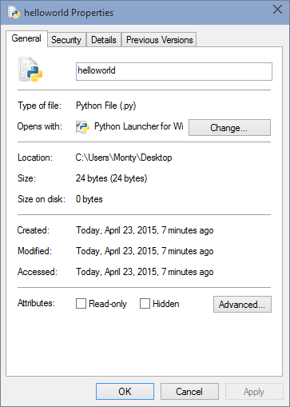
Python Scripts and Files

Slide 16
Comments
# User hasn't yet exited the window.
done = False

Slide 17
Program Docstring
"""This program gets a user's input and returns a game board back to them."""

Slide 18

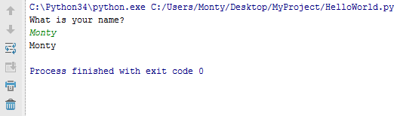
The input() Function
Prompt
User input
Print

Slide 19
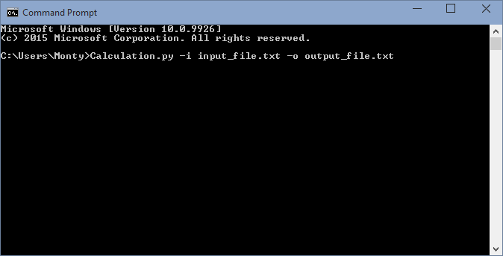
Command Line Arguments
Name of Python script
Input file argument
Output file argument

Slide 20
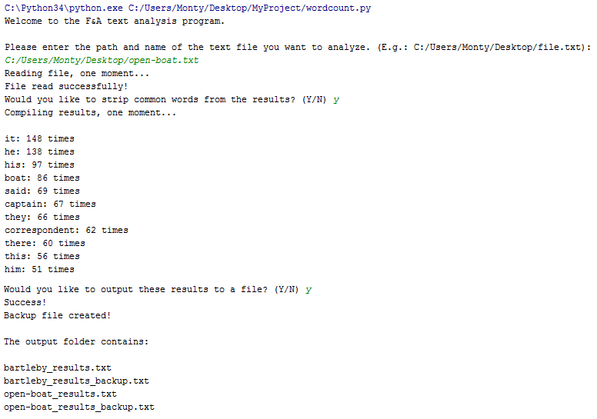
Activity: Creating a Python Application

Slide 21
Types of Errors in Python
Syntax errors
Logic errors
Exceptions

Slide 22
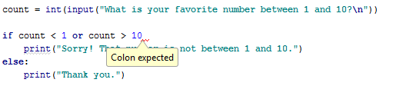
Syntax Error

Slide 23
Logic Error
fav_number = input(“What is your favorite number?”)
fav_color = input(“What is your favorite number?”)
print(fav_number)
print(fav_color)

Slide 24
Guidelines for Preventing Errors
Use an IDE with error indicators to detect syntax errors before execution.
Use an IDE with code suggestion or completion to help you resolve syntax errors.
Type carefully, and always remember to indent loops, conditional statements, function definitions, and other objects.
Remember to add a colon at the end of the first line of most of these objects.
Know Python's reserved words list so you don't accidentally try to use one as a variable.
Use docstrings and comments to adequately explain what every block of code should do.
Try to envision how a block of code could affect the whole program if it fails to execute as intended.
Watch for loops that never initiate or terminate.
Thoroughly test larger, more complex programs before releasing them to a wider audience.
During testing, attempt to "break" your code, i.e., test how the code handles unconventional or uncommon input.

Slide 25
Reflective Questions
1. What about Python is different than the other programming languages you've used or have heard of?
2. When do you think you'll use interactive mode versus running a Python script normally?

